Slide 1
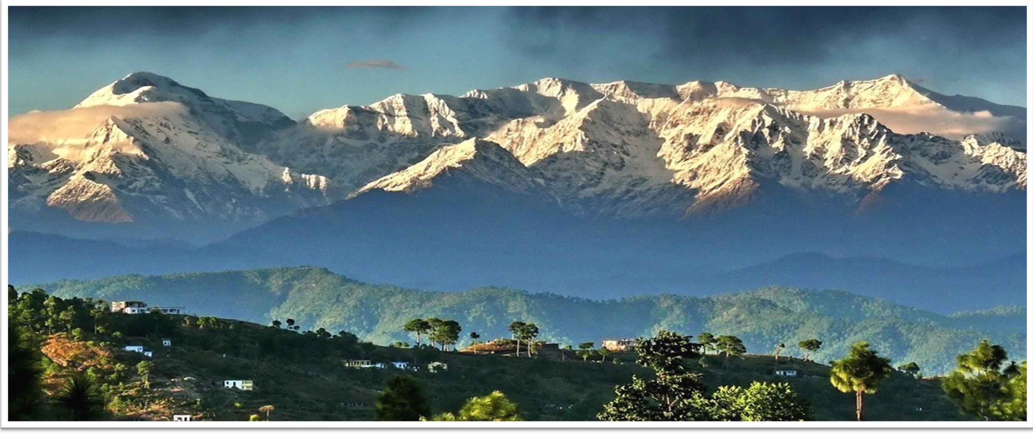
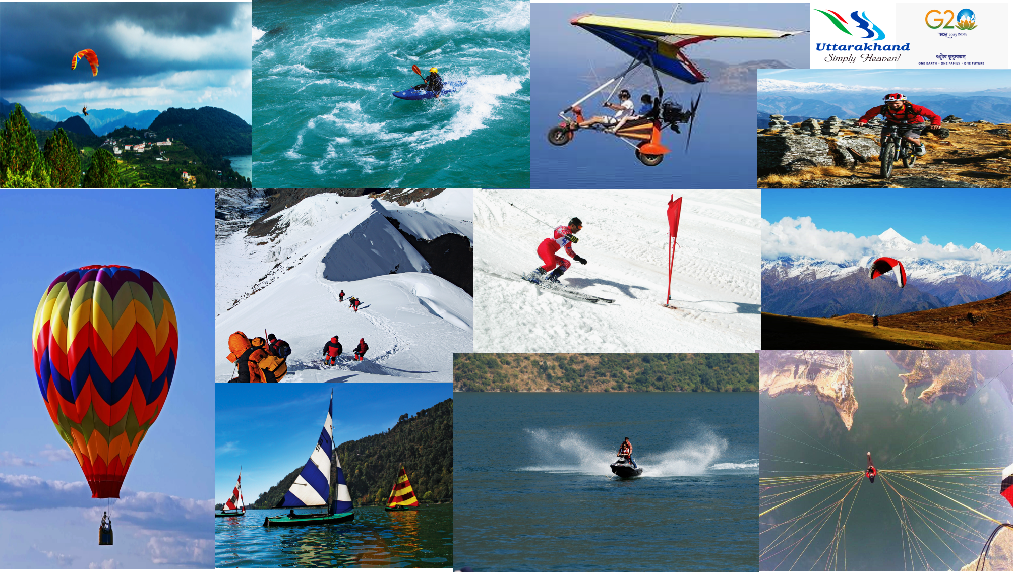
Addressing Challenges of Rural and Adventure Tourism in Uttarakhand
Colonel Ashvini Pundir
Addl CEO, ADVENTURE
Uttarakhand Tourism Development Board
1

Slide 2
Key Challenges in Rural Tourism in Uttarakhand
Locations
Vast & Remote area, Dependence on Road network, connectivity issues.
Low density of population .
Lack of basic tourist infrastructure- Electricity, Water, internet.
Lack of multiple itinerary options.
People
Eco sensitive zone prone to landslides.
Acclimatization issues, Medical facilities and evacuation.
Currency exchange/Payment options.
Workation/ Long stays.
Language- Hindi/Local.
Training of Homestay owners/ Culinary options-Safety, Hygiene.

Slide 3
Challenge Mitigation Strategy Rural Tourism
Locations
Improving Road NW, Ropeways, Heli/ Fixed Wing connectivity/ Internet Backbone.
Reverse migration/ employment Generation/SDG/ Vibrant villages( Niti, Mana, Gunji) .
Linking Destinations to activity - Niche(Adventure, Haat, MICE, Training, Agro, Heritage, Astro).
People
Hunar se Rojgar/CBSP- Cooks, Waiters, Hkeeping, Front office, Dhabas
EIA, carrying capacities.
Destinations in between/ wayside amenities, Improving Medical facilities, Ambulance/Heli evacuation.
Language – Soft skills Trg .
Payment Gateways like PayTM, Gpay etc.
Homestays/ Infra Development- Electricity, Traditional water sources/ harvesting, Fibre optics NW.
Search and Rescue, CPR, Evac protocols.
Online services –Flt/ Hotel/ Homestay Booking, Cabs, Food.
Apps like Zomato, Swiggy.

Slide 4
Challenges in Rural Tourism
High altitude risk prone Areas
Lack of Infrastructure, Shortage of modern accommodation
Parking challenges in mountains
Seasonal Nature
Lack of Rail and Air connectivity
Shortage of skilled personnel, trained guides etc
Problems of Solid waste Management
Lack of adequate public conveniences facilities
Drinking water problem
Proper visitor Management
Medical facilities in border areas
ATM Facility/ poor internet connectivity
Lack of awareness of regulations
Lack of knowledge amongst locals of what to promote in terms of culture

Slide 5
Key Challenges in Adventure Tourism in Uttarakhand
Policy Challenges
As there was no National Adventure policy in the past, the state has its own Rules and regulation for aero and water sports .
In Aero sports (Paragliding 14 firms) have been granted permission for commercial flying with 29 pilots in 5 Districts.
In River Rafting Permission to 278 firms for 625 Rafts in 10 Rivers of Uttarakhand(Ganga, Yamuna, Kali, Tons, Alaknanda,Sarayu, Kosi, Ramganga west, Ramganga east, & Pindar River)
ATOAI Guidelines
High Court interventions
Carrying capacity
Safety , Search and Rescue issues

Slide 6
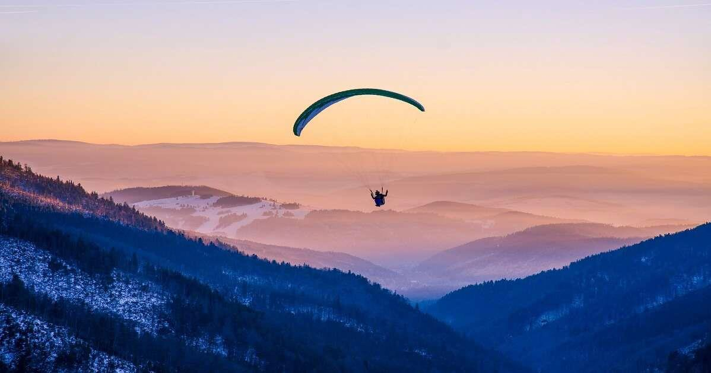
SUMMARY OF ADVENTURE WING
S.No. | Policy | Licences Issued
1. | Foot Launched Aero Sports Rules 2018/19 | 18 Firms/ 40 Pilots
2. | River Rafting/ Kayaking Rules 2014/18 | 285 Firms/ 631 River Guides
3. | Tracking Traction Centre Yojana 2020 | 73 Villages/ 13 Destination/ 18Homestays / 113 Trekking Guides
4. | Revised Mountaineering Guidelines 2021
5. | Online Portal for Mountaineering / Trekking/ Angling permits
6. | Opening of New Peaks
7. | Expenditure of Amounts received in (Mountaineering) borne by Tourism for Indians
8. | Transfer of forest land for Adventure Activities
9. | Angling Guidelines
10. | Uttarakhand Trekking Rules 2023(Drafted).

Slide 7
Skill Development and Capacity Building 2022-23
Products | Training programme | No of people trained
Land based activities | Low altitude guides High altitude treks Skiing Adventure Instructors refresher training. | 223 youth 25 youth 60 youth 65
Air based activities | Paragliding courses First aid and CPR Operators/Pilots training on Tandem Paragliding Safety Reserve packing clinic | 30 Youth 40 Pilots 40 Pilots /15 Operators (55) 40 Pilots
Water based activities | Kayaking/Rowing/Canoeing First aid and CPR | 176 youths 669 guides. 1383
TOTAL

Slide 8
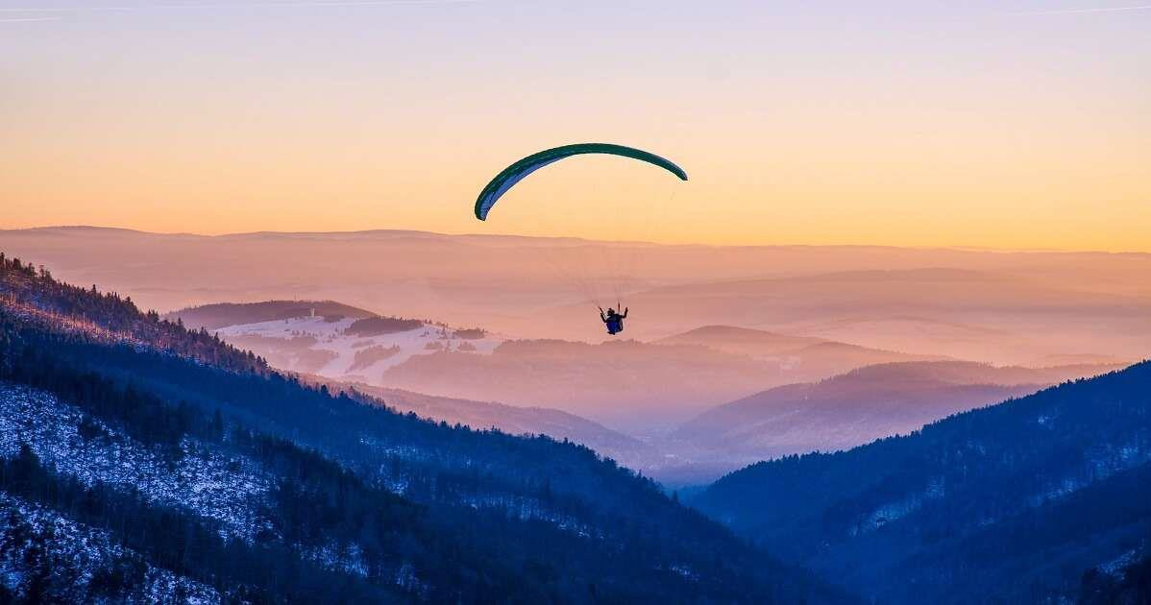
Breakfast Tourism/Himalaya Darshan
Sl No. | Projects | Activity
1. | George Everest, Mussoorie | Helipad (Heliride/ Himalaya Darshan)
2. | Kalsi, Vikasnagar | Airstrip (Ballooning, Heli, Gyrocopter, Paragliding, Paramotoring)
3. | Bairagi Camp, Haridwar | Airstrip (Ballooning, Heli, Gyrocopter, Paragliding, Paramotoring)
4. | Janki Setu, Rishikesh | Helipad (Heliride/ Himalaya Darshan)
5. | Chinyali Saur, Uttarkashi | Airstrip (Ballooning, Heli, Gyrocopter, Paragliding, Paramotoring)
6. | Gaucher, Chamoli | Airstrip (Ballooning, Heli, Gyrocopter, Paragliding, Paramotoring)
7. | Naini Saini, Pithoragarh | Airstrip (Ballooning, Heli, Gyrocopter, Paragliding, Paramotoring)
8. | Raithal, Dayara, Uttarkashi | Helipad (Heliride/ Himalaya Darshan)
9. | Harsil, Uttarkashi | Helipad (Heliride/ Himalaya Darshan)
10. | Naukuchiyataal, Nainitaal | Helipad (Heliride/ Himalaya Darshan)
11. | Pantnagar | Airstrip (Ballooning, Heli, Gyrocopter, Paragliding, Paramotoring)

Slide 9
Breakfast Tourism/Himalaya Darshan
(Proposed Routes)
HARSIL
GAUCHER
RAITHAL
NAINISAINI
CHINYALI SAUR
NAINITAL
RISHIKESH
GEAROGE EVEREST
(Mussoorie)
KALSI
PANTNAGAR
BAIRAGI CAMP
(Haridwar)

Slide 10
